Slide 1
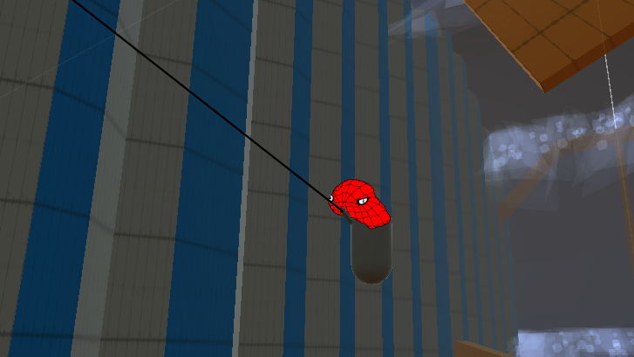
Budget Spiderman
By: Christian Petersen

Slide 2
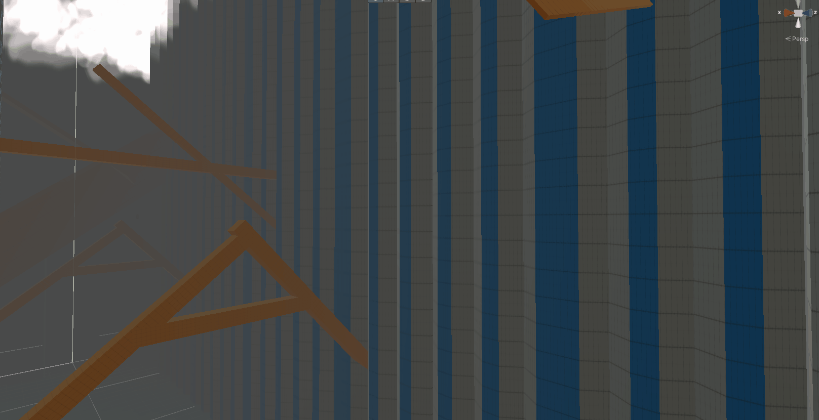
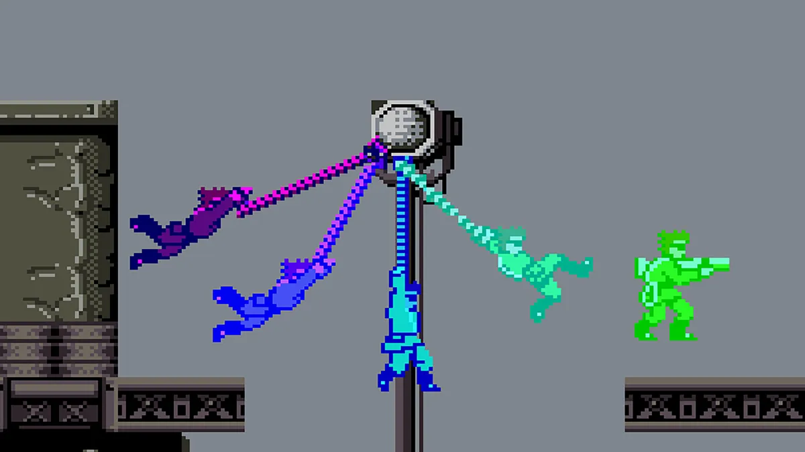
Idea
Source:
https://www.avclub.com/30-years-ago-bionic-commando-proved-video-game-grappli-1827755958
An endless runner, not like subway surfers, but more 3D traversal and physics based.
Player has first person control and swings away from a “wave” that is chasing the player into a narrow set of prefabs that randomly get chosen to spawn one after another.
GOAL: Get as much score as possible or swing forever.

Slide 3
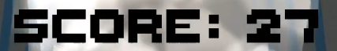
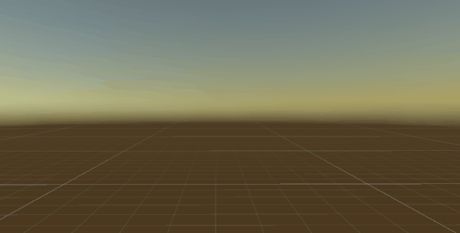

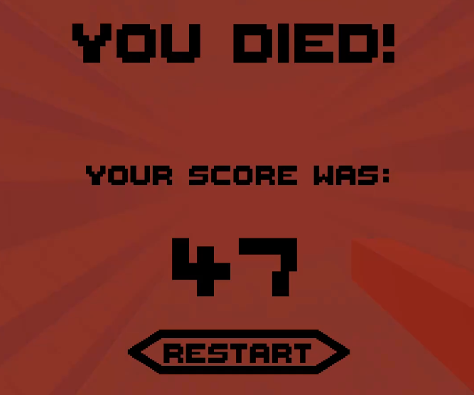
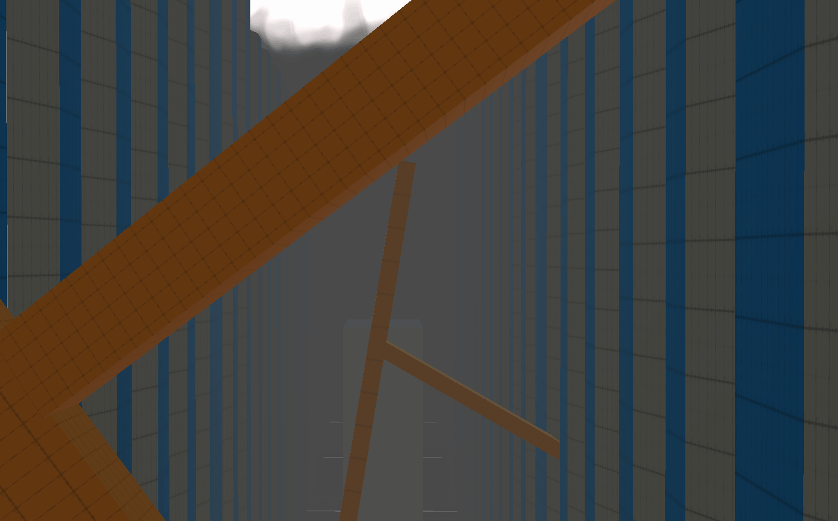
Features
Random Selection of prefab levels with spacing between, forever
Score counting
Speed Counter
Game Loop (Death)
Wave chasing player
Grappling Mechanic

Slide 4
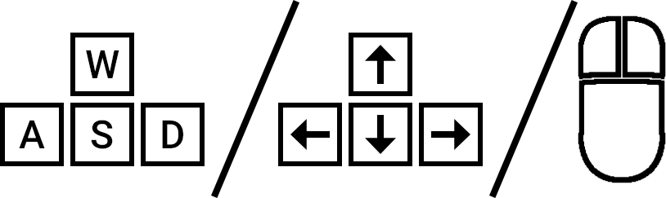
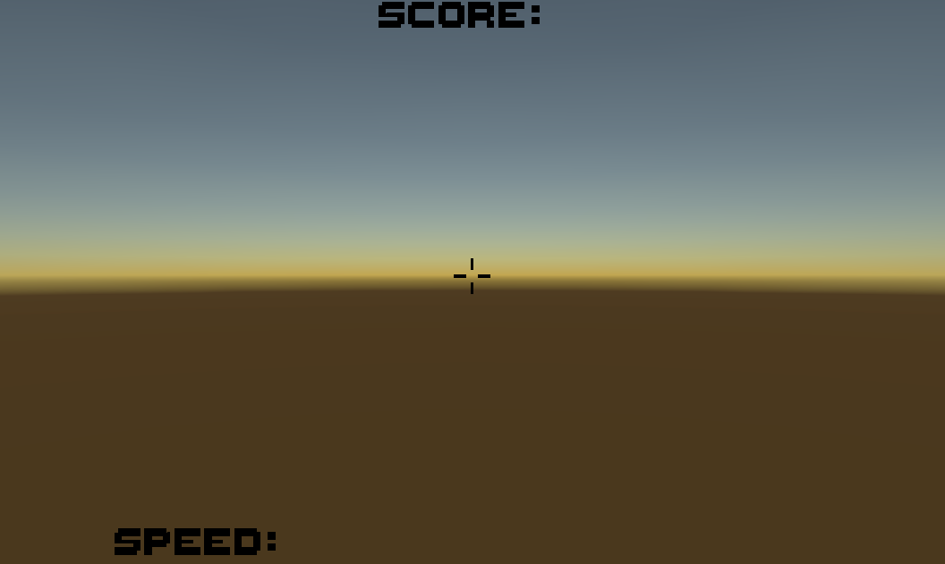
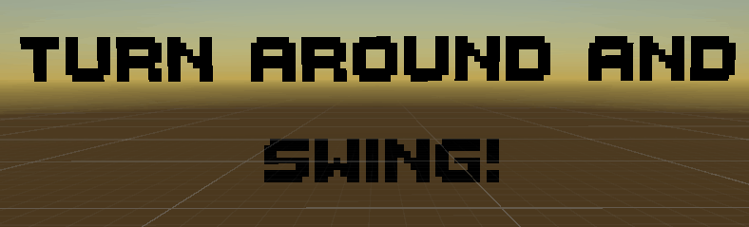
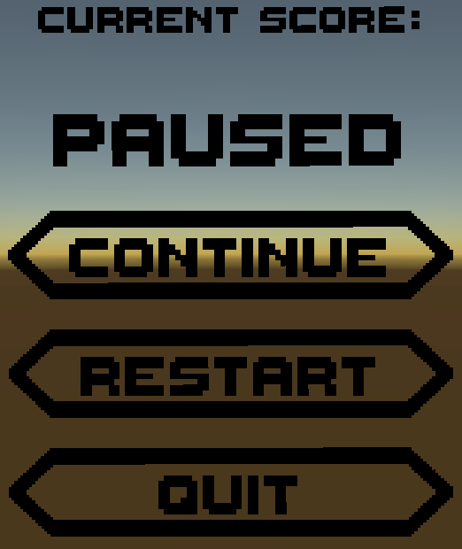
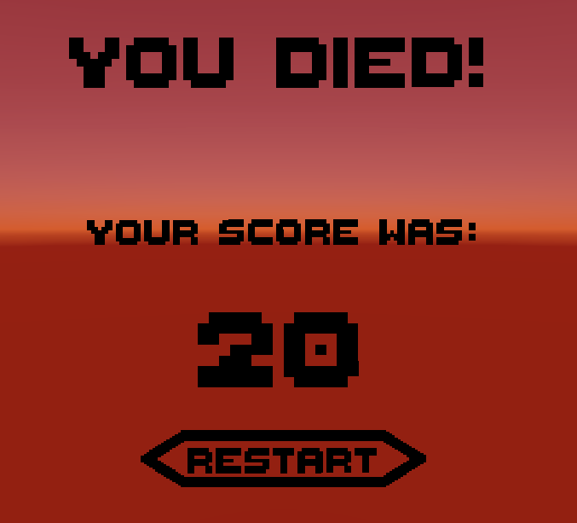
GUI & Controls
Controls:
UI Stats
Start Screen
UI Pause
UI Death

Slide 5
Scripts
*Same color means they interact with one another*
MovementScript
Contains everything for moving, as well as air multipliers to limit movement, making the player have to sort of skillfully use the grapple
Has control of all the UI’s, where it also stores the speed and score that gets updated on the Status UI
Controls the FOV of the camera depending on the speed
Controls the players ability to look around
CameraMove
Makes sure camera is stuck on head position
GameManager
Contains the array of level pieces that will be used to randomly spawn ahead of the player
Contains method used by ”TriggerExit” to spawn new level piece
Contains amount of level pieces spawned and deletes old pieces
RandomHeight
Is put on the building prefabs and scales their heights randomly so as to give the feel that there is more variation
RotateGrapple
Controls the rotation of the grapple so the tip faces the joint its hooked to
Grappling
Contains necessary methods to produce the spring joint that connects to a grapple-able object
Has extra grapple pull to allow player to gain speed
Makes sure that the rope being rendered does not start from main camera, but from the tip of the game
TriggerExit
Set on an invisible trigger that is on every prefabs center
This controls when to let the MovementScript know that it should add onto the score
WaveMove
Tells the wave how fast it can move along with how fast it accelerates
Also says to kill player if it collides with the player

Slide 6
DEMONSTRATION
/
Video

